Slide 1
AGU 2013
IN22A-07 :: The ES-DOC Software Process

Slide 2
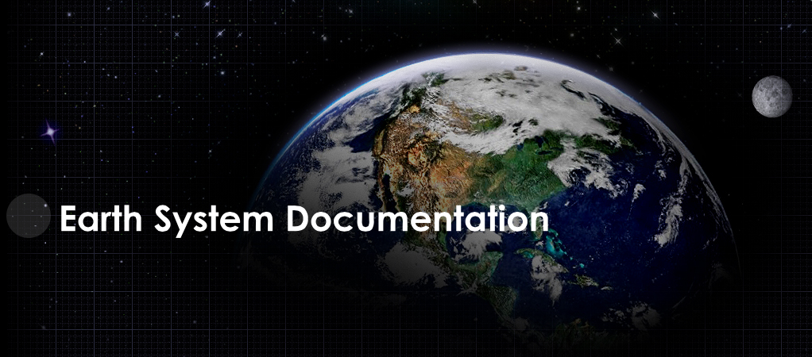


Slide 3
Mission
Nurture a standards based eco-system in support of earth system documentation creation, analysis & dissemination.

Slide 4
Sub-Domains
2013
Earth System Models
Statistical Downscaling
2014
Obs4MIPs ?

Slide 5
Strategic Relevance
EXA-Scale requires quality documentation

Slide 6
http://es-doc.org

Slide 7
#esdocumentation

Slide 8
Funders
IPSL (EU)
NOAA (US)
EX-ARCH (G8)
ISENES-2 (EU)

Slide 9
PI’s
Venkatramani Balaji (US - NOAA)
Cecelia DeLuca (US - NOAA)
Sébastien Denvil (EU - IPSL)
Eric Guilyardi (EU - IPSL)
Bryan Lawrence (EU - BADC)
Karl Taylor (US - PCMDI)

Slide 10
Core Team
Sylvia Murphy (US - NOAA)
Allyn Treshansky (US - NOAA)
Mark Greenslade (EU - IPSL)

Slide 11
Tools
Create
Search
View
Compare
Visualize

Slide 12
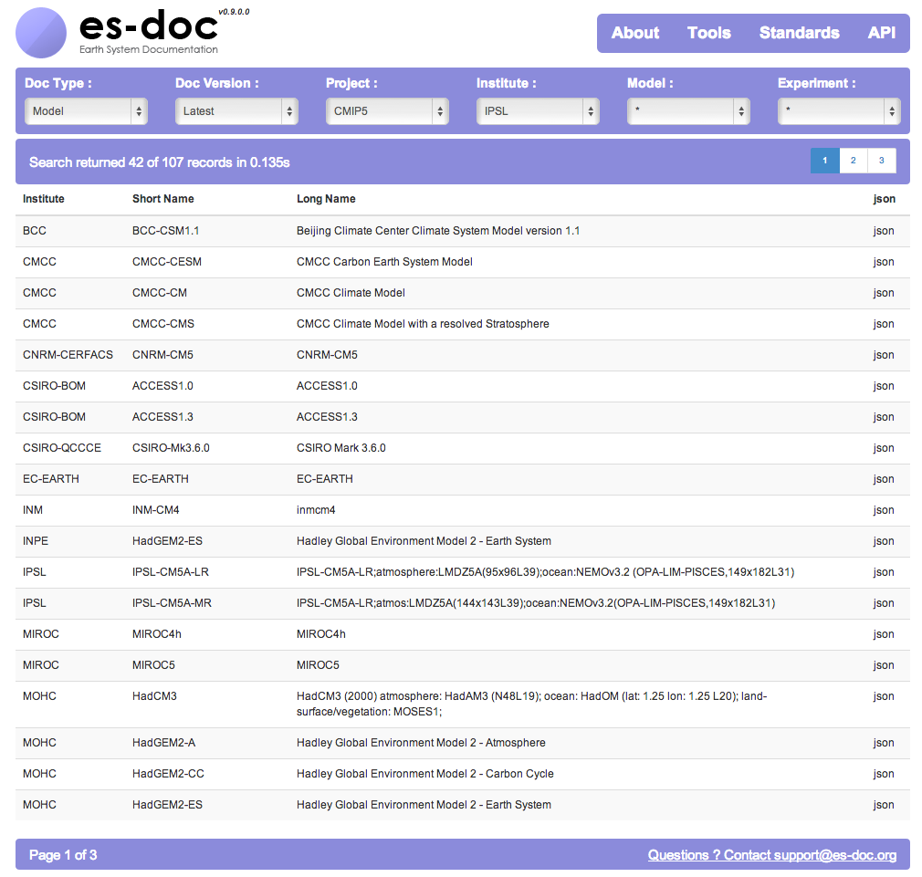

Slide 13
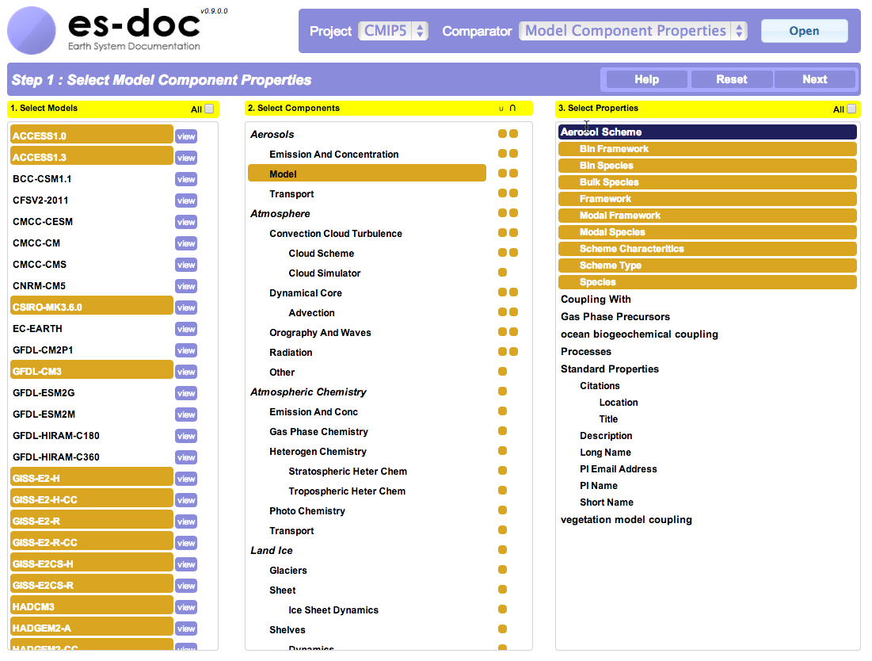

Slide 14
API
Publish
Search
Compare
Visualize

Slide 15
API Clients
2013
Python
2014
C, Java

Slide 16
Demo
CMIP5 Comparator

Slide 17
Process
Social or Technical ?

Slide 18
Social Process

Slide 19
before software comes dialog

Slide 20
Social Process
Requirements Capture
scientist engagement
prioritization
scoping
politics

Slide 21
Social Process
Self Organization
roles
responsibilities
mutual respect

Slide 22
Social Process
Transparency
visibilty
accountability
traceability

Slide 23
Social Process
Ethos
commitment to quality
determination
sense of humor !

Slide 24
Social Process
Communication (internal)
face to face
telcos
wiki
email

Slide 25
Social Process
Communication (external)
advocacy
splash page (see branding)
social media

Slide 26
Social Process
Goals
achievable
collectively decided
iterative

Slide 27
Technical Process

Slide 28
after dialog comes software

Slide 29
Technical Process
Information Architecture
domain driven design
ontologies

Slide 30
Technical Process
Meta-programming
Code generation
Multi-language support
Supports quaility

Slide 31
Technical Process
Map Reduce
700,00 lines of XML
4D array

Slide 32
Technical Process
User Experience
UI first
Usability testing

Slide 33
Technical Process
Web Services
HTTP
REST vs RPC
Encoding (JSON)
Security

Slide 34
Technical Process
Polygot Programming
python
javascript
bash

Slide 35
Technical Process
Testing
Automated Testing
Unit, Functional, Integration
CI Server
Executed upon check in

Slide 36
Technical Process
Deployment
Today: single click
Tomorrow: fully automated

Slide 37
Conclusions

Slide 38
Conclusion - 1
Scripter Developer Engineer Architect
In the absence of systematic training, internships, & mentoring, scientists will not get beyond developer status

Slide 39
Conclusion - 2
Strong Repeatable Social Process
The social process is undervalued yet once learnt is transferable between projects

